Slide 1
DIAGNOSIS OF ACUTE DISEASES IN VILLAGES AND SMALLER TOWNS USING AI
PIP2001 Capstone Project
Final Viva-Voce
Batch Number : CAI-G14
Roll Number | Student Name
20211CAI0155 20211CAI0153 20211CAI0121 20211CAI0099 20211CAI0131 | Benakeshwar G K Vishwas Chandra C Gautham Ashwani Darshan Karthik K J Preethi N
Under the Supervision of,
Dr. MURALI PARAMESWARAN
Professor
School of Computer Science and Engineering
Presidency University
Name of the Program: B.E in Computer Science and Engineering , Specialization in Artificial Intelligence & Machine Learning
Name of the HoD: Dr. Zafar Ali Khan
Name of the Program Project Coordinator: Dr. Afroz Pasha
Name of the School Project Coordinators: Dr. Sampath A K / Dr. Abdul Khadar A / Mr. Md Ziaur Rahman

Slide 2
Introduction
We are in the process of creating an artificial intelligence based chatbot for diagnosing dangerous diseases and health consultation for the symptoms.
Our solution fills the lack of coverage in areas with less access to medical providers, providing instant assistance and allowing people to make knowledgeable choices.
Especially, we concentrate on making affordable diagnostic services available to small towns and rural areas so that local resources are relieved and services are timely.

Slide 3
Abstract
AI Chatbot Solution:
Our reason for focusing on rural regions is to overcome the existing shortcomings in accessible health care by creating an AI-based chatbot that would help diagnose dangerous diseases and offer necessary health consultation.
This solution helps to fill the rural healthcare deficit by providing affordable and easy to use diagnostics, as well as providing residents with access to crucial healthcare resources.

Slide 4
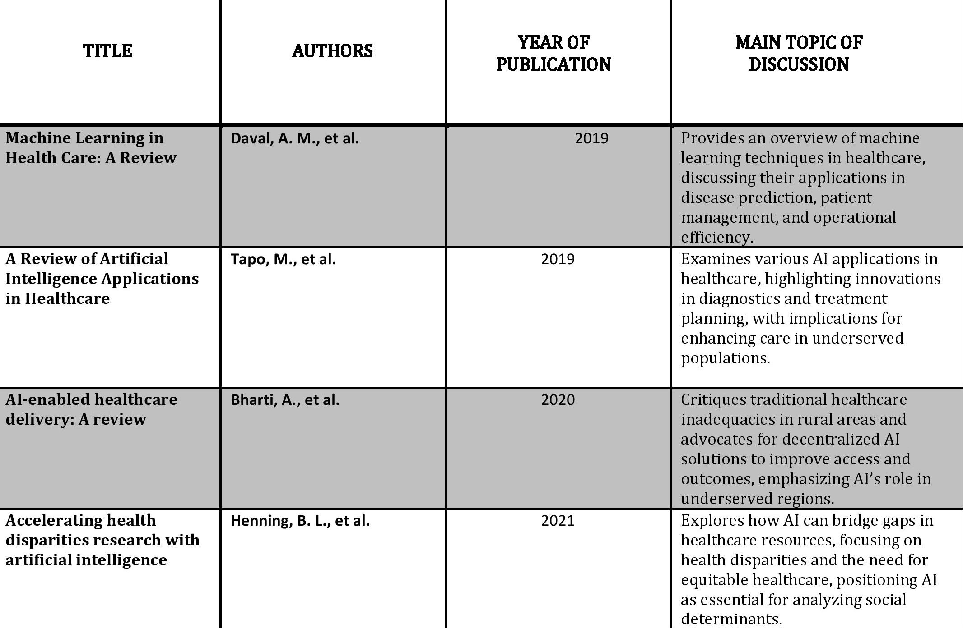
Literature Review

Slide 5
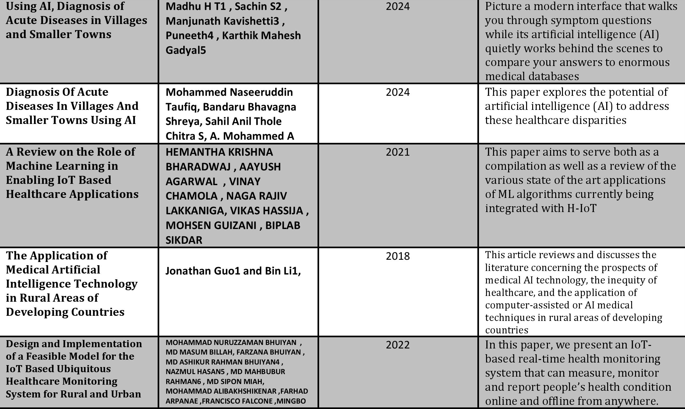

Slide 6
Drawbacks Of Existing Methods
1. ACCURACY
2. LANGUAGE BARRIER
.

Slide 7
Proposed Method
Data Extraction and Chunking
Embedding Creation and Semantic Indexing
Knowledge Base Development
User Query Processing
Response Generation with OpenAI
Patient Empowerment and Self-Management

Slide 8
Objectives
Early and accurate detection
Language wise Assistance
Emergency Assistance
Health Education

Slide 9
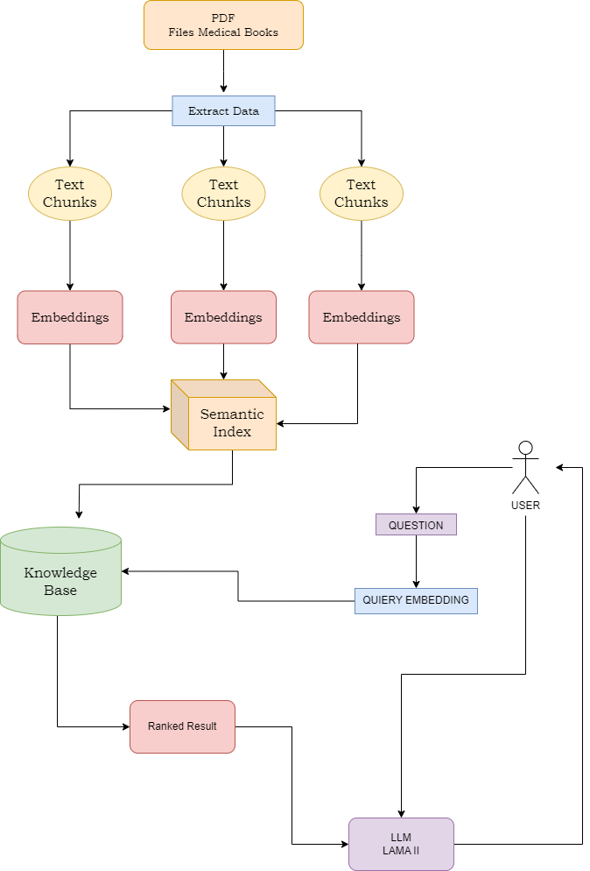
Architecture
Open AI

Slide 10
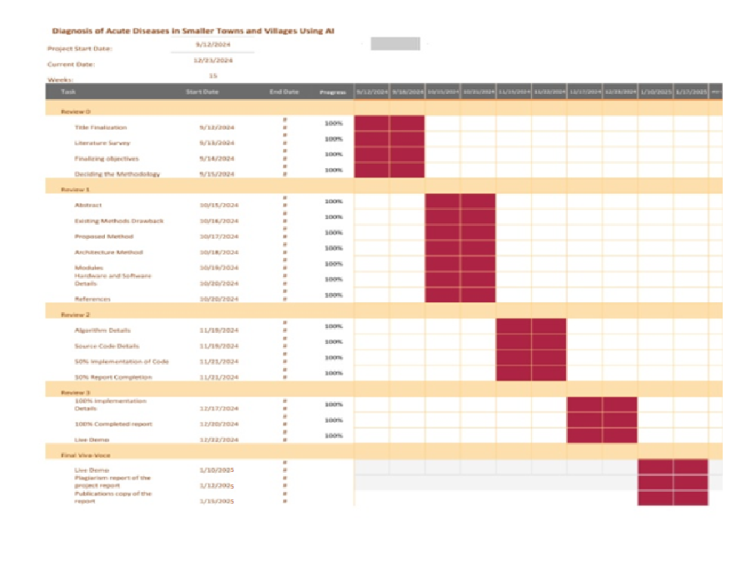
Timeline of Project

Slide 11
Expected Outcomes
Using OpenAI Embeddings allows for richer and more granular semantic representation, leading to better accuracy in retrieving contextually similar documents.
Improved Accessibility
Improved Health Outcomes at Rural Areas

Slide 12
Conclusion
The project aim’s to help improve rural healthcare through AI.
It provides early diagnosis, easing healthcare worker burdens and offering affordable, scalable care.
Future efforts will focus on refining AI models and enhancing integration with local healthcare systems.

Slide 13
Github Link
https://github.com/punyathma/A-cuteAI
https://github.com/BenakeshwarGK/AcuteAI

Slide 14
References
Kumar Y, Koul A, Singla R, Ijaz MF. "Artificial intelligence in disease diagnosis: a systematic literature review, synthesizing framework and future research agenda." J Ambient Intell Humaniz Comput. 2023;14(7):8459-8486. doi:10.1007/s12652-021-03612-z.
Guo, Jonathan & Li, Bin. (2018). "The Application of Medical Artificial Intelligence Technology in Rural Areas of Developing Countries." Health Equity. 2:174-181. doi:10.1089/heq.2018.0037.
Pathak, Chandramaprasad and Ansari, Namrata. "Chatbot based Disease Prediction and Treatment Recommendation using AI." (May 7, 2021).
Available at SSRN: https://ssrn.com/abstract=3869072
Fan X, Chao D, Zhang Z, Wang D, Li X, Tian F. "Utilization of Self-Diagnosis Health Chatbots in Real-World Settings: Case Study." J Med Internet Res. 2021 Jan 6;23(1)
Diagnosis Of Acute Diseases In Villages And SmallerTowns Using AIMohammed Naseeruddin Taufiq, Bandaru Bhavagna Shreya, Sahil Anil Thole Chitra S, A.Mohammed A
Using AI, Diagnosis of Acute Diseases in Villages and Smaller TownsMadhu H T1, Sachin S2, Manjunath Kavishetti3 , Puneeth4 , Karthik Mahesh Gadyal5
.Chakraborty, Sanjay, Paul, Hrithik, Ghatak, Sayani, Pandey, Saroj, Kumar, Ankit, Singh, Kamred, & Shah, Mohd Asif. (2023). "An AI-Based Medical Chatbot Model for Infectious Disease Prediction." IEEE Access. PP. 1-1. doi:10.1109/ACCESS.2022.3227208.

Slide 15
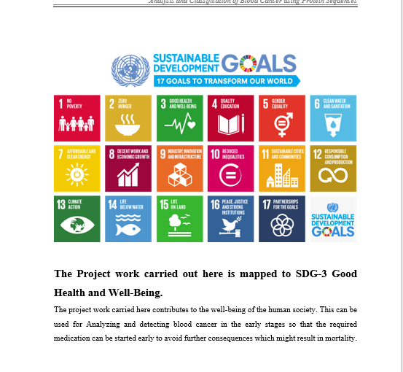
Project work mapping with SDG
SDG 1:No Poverty
The main Idea behind our project is to aid healthcare to all , without any poverty barrier.
SDG 3: Good Health and Well-Being
Promoting best possiible health diagnostics to all for everyone’s well-being.
SDG 9: Industry, Innovation, and Infrastructure
Our project , AI in medicine , hasn’t made a big market yet , making space for much more innovation and improvement in the particular Industry.
SDG 10: Reduced Inequalities
Provinding equal health facilities to all , without any barriers.
SDG 17: Partnerships for the Goals
By tying up with Non Profitable Organizations , Charitable Trusts , our project is open in looking for partnerships to fulfill our future goals.

Slide 16
THANK YOU

